Slide 1

Design and Simulation of Digital Even and Odd Parity Generator Using XOR Gates
Digital Logic Design | Circuit Design & Simulation

Slide 2

Why Do We Need Parity?
THE PROBLEM
Original Data
Data in Transit is Vulnerable
Digital transmission is susceptible to noise and bit-flip errors. A single corrupted bit can silently corrupt data — undetected.
1011 — 4 bits
Parity Bit Added
THE SOLUTION
Extra bit: 1
Add One Extra Bit
A parity bit is appended to original data, enabling the receiver to verify data integrity with a single check.
Transmitted
10111 — 5 bits
Receiver Checks
Verifies parity bit against received data ✓

Slide 3

Even vs Odd Parity
EVEN PARITY
ODD PARITY
Total 1s must be EVEN
Total 1s must be ODD
Data: 1011 → three 1s (odd count)
Even parity bit = 1
Transmitted: 10111 → four 1s ✓
Data: 1011 → three 1s (odd count)
Odd parity bit = 0
Transmitted: 10110 → three 1s ✓
Parity bit chosen to make the total count of 1s even.
Parity bit chosen to keep the total count of 1s odd.
Same data, different parity scheme — the bit flips!

Slide 4

XOR Gate: The Building Block
XOR Truth Table — A ⊕ B
A
B
A ⊕ B
0
0
0
0
1
1
1
0
1
1
1
0
Output = 1 only when inputs are DIFFERENT

Slide 5
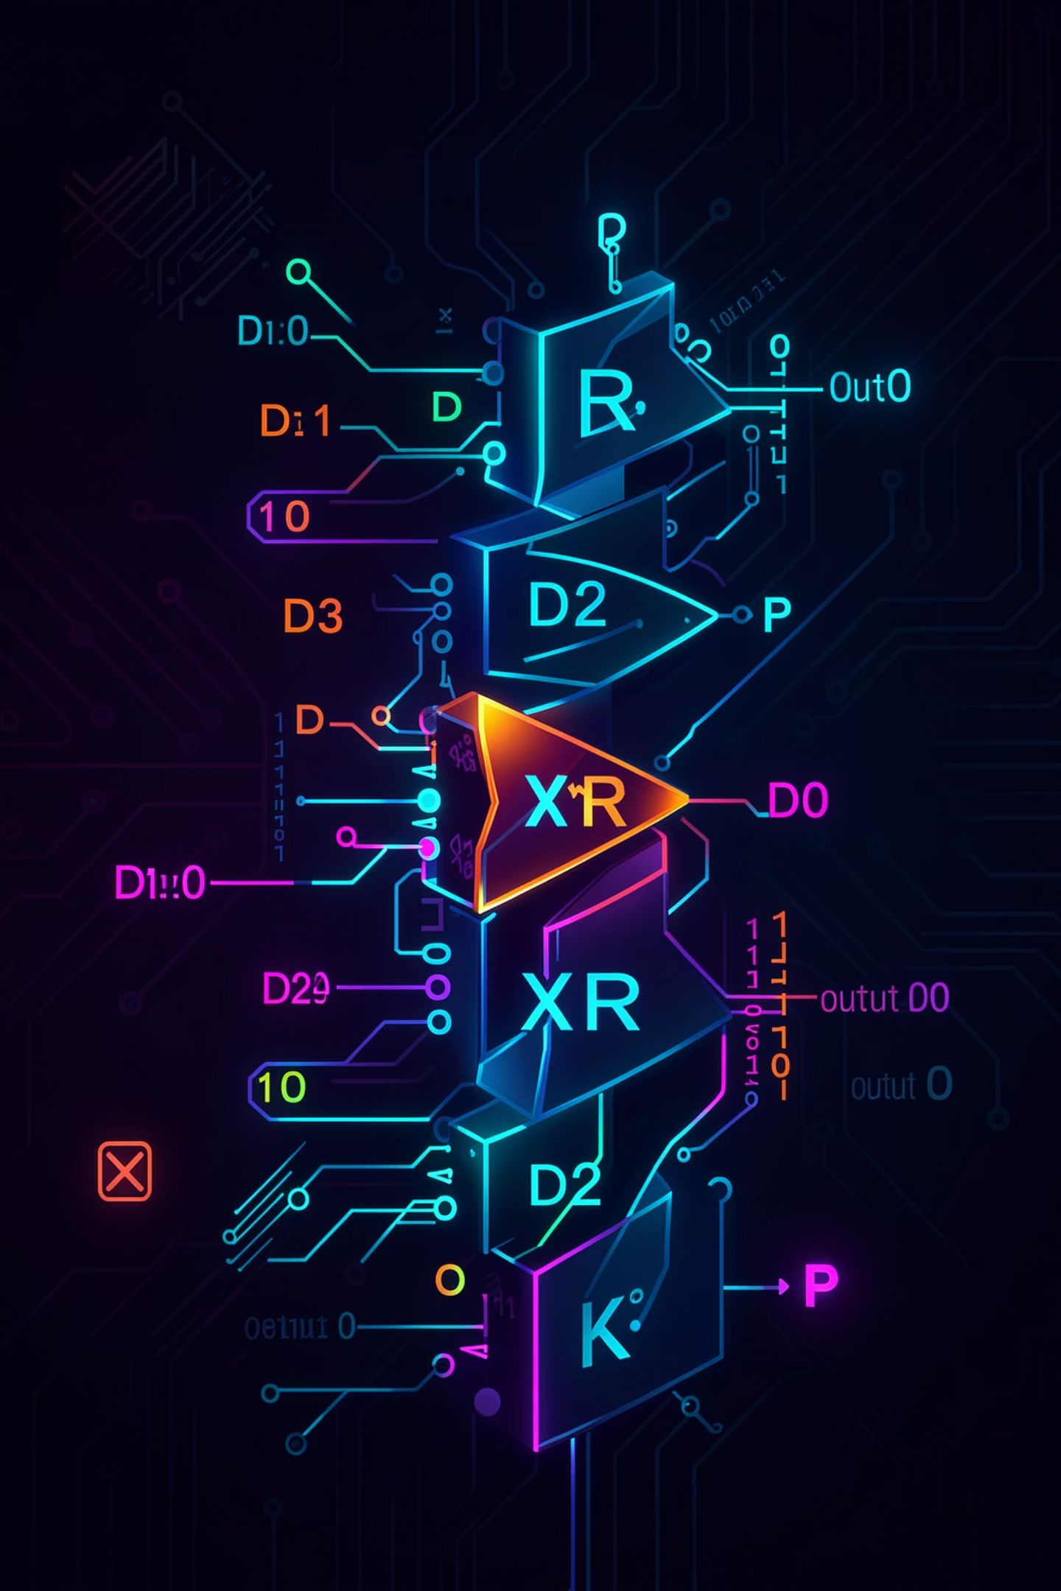
Cascaded XOR for Parity Generation
Logic Equation
P = 0
P = D₃ ⊕ D₂ ⊕ D₁ ⊕ D₀
Even number of 1s in input
Even parity output
P = 1
Odd number of 1s in input
Odd parity output
XOR naturally tracks the parity of input bits — no additional logic required.

Slide 6
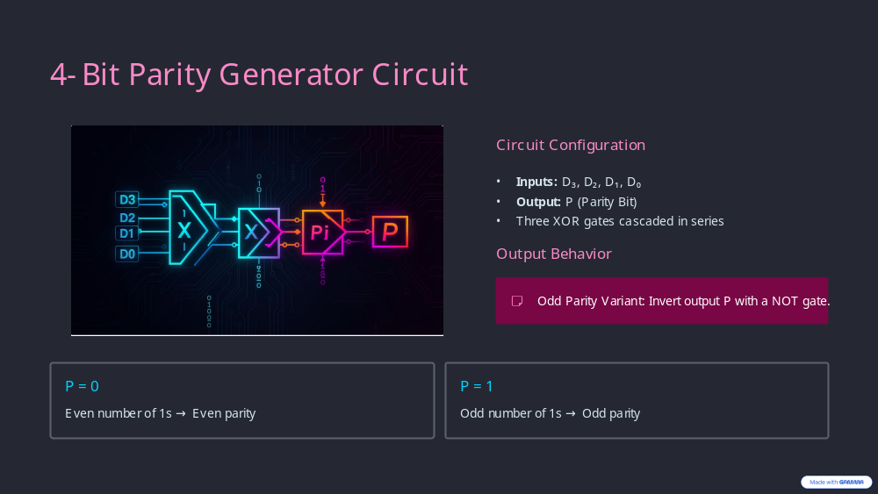

Slide 7


Logisim Simulation
TEST CASE: INPUT = 1011
Signal Values
D₃ = 1 D₂ = 0 D₁ = 1 D₀ = 1
XOR Cascade
1 ⊕ 0 ⊕ 1 ⊕ 1 = 1
Number of 1s = 3 (odd)
Even Parity Bit
Output P = 1 ✓ — LED indicator: ON
Circuit successfully generates the required parity bit.

Slide 8





Real-World Applications
Data Communication
Computer Networks
Memory Systems
Digital Electronics
Detects single-bit errors in serial and parallel data links
Error-detection layer in network protocols and packet transmission
Detects data corruption in RAM and storage devices
Foundation for error-detection and error-correction circuit design
⚠ Limitation: Parity cannot detect all multiple-bit error patterns. For stronger protection, use Hamming codes or CRC.

Slide 9
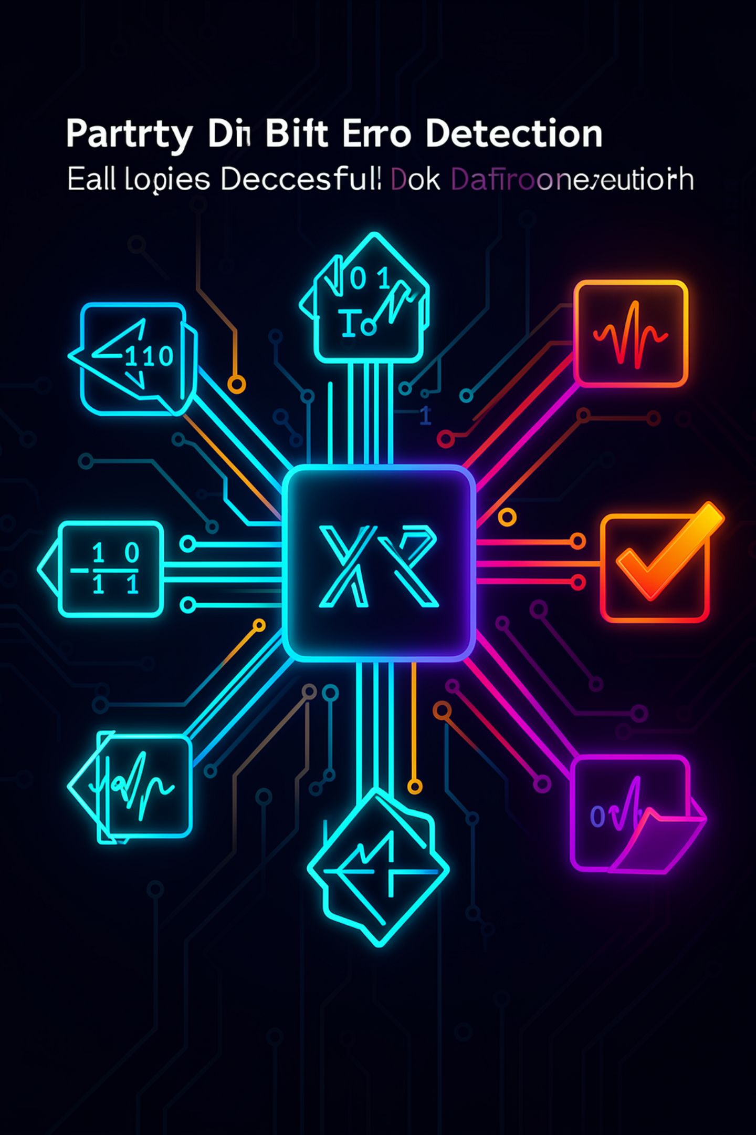

One Extra Bit. One Simple Check. Better Data Reliability.
Input Data
XOR Network
Parity Bit
Error Detection
XOR gates provide a simple, elegant method to generate parity bits
Even and odd parity implemented using basic cascaded logic gates
Low-cost, fast, and easy to simulate in digital design tools
Parity is foundational to digital error-detection and data integrity
Questions & Discussion

